Slide 1
O
From Transactions Strategy
Unlocking Customer Purchasing Patterns with Market Basket Analysis
W NotebaokLM

Slide 2




Our Analysis Revealed Five Actionable Customer
Behavior Patterns
We applied association rule mining to Indian household transaction data to uncover how customers shop. This analysis moved beyond simple product popularity to identify statistically significant co-purchase behaviors.
Staple Products as Anchors Core items like Atta and Rice form the foundation of most baskets.
Strong Complementary Pairs
Discovered powerful product bundles like Paneer with Tea & Milk.
Untapped Cross-Category Links
Found connections between groceries and personal care.
O
Directional Purchasing Habits
Identified ’trigger’ products that reliably lead to other sales.
Data-Driven Decision Framework Established a robust method for future merchandising tests.
These insights provide a clear roadmap for optimizing product placement, promotions, and bundling strategies to increase basket value.

Slide 3





The Core Challenge: Understanding the ‘Why’ Behind Every Purchase
How can we move from knowing what customers buy to to understanding how they buy?
Increase average basket value through
effective cross-selling.
Optimize shelf placement based on real- world shopping habits.
Design promotions and product bundles
that resonate with customers.
Gain a competitive edge through data-
driven merchandising.

Slide 4
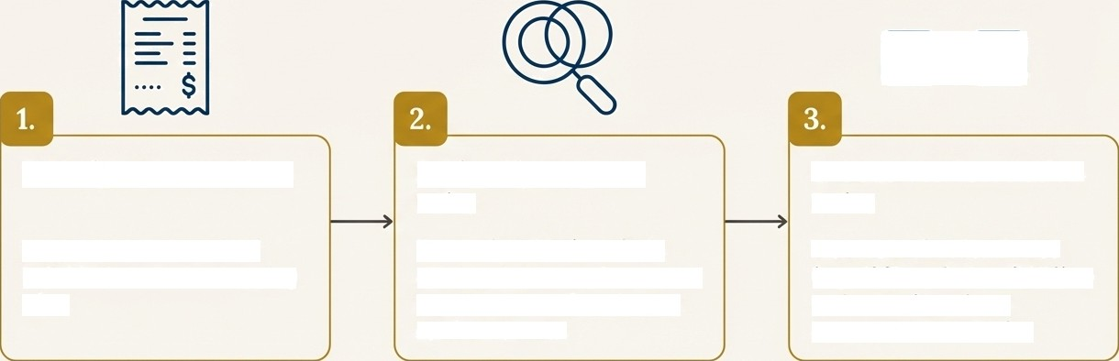

Our Approach:
Market Basket Analysis
Market Basket Analysis is a data mining technique used to discover co-occurrence patterns between items in
a transaction. It answers the classic question: 'Customers who bought Product X also bought Product Y'
1. Analyze Transactions
2. Identify Frequent
Pairs
The Apriori algorithm finds item combinations that appear together more often than by random chance.
3. Generate Association
Rules
We create directional rules (e.g., If (Bread}, then (Milk)) to understand purchase sequence and behavior.
We process thousands of individual customer shopping trips.
Source Data: The analysis was performed on survey-based transaction data representing common Indian household purchases.

Slide 5



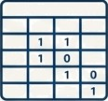

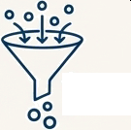


A Rigorous, Multi-Step Process to Ensure Reliable Insights
1. Data
Structuring
Raw survey data (binary 1/0 format) is converted into a list of items for each transaction.
2. Frequent
Itemset Mining
The Apriori algorithm is used to identify all item combinations with a minimum support of 20%.
3. Rule Generation
Association rules are generated from frequent itemsets based on a minimum confidence of 60%.
LIFT > 1
4. Strategic Filtering
Rules are filtered for a Lift > 1 to isolate statistically significant associations and remove random co- occurrences.

Slide 6



Translating Statistics into Business Logic:
Our Key Metrics
SUPPORT
The popularity of an item or item set. It measures how frequently it appears in all transactions.
CONFIDENCE
The likelihood of purchasing Item Y, given that Item X has been purchased.
LIFT
The increase in the probability of purchasing Item Y when Item X is purchased. A Lift > 1 indicates a non- random, meaningful association.
Business Question: How common is this product combination?
Business Question: If a customer buys X, how often do they also buy Y?
Business Question: How much more likely is a customer to buy Y because they bought X?
min_support = 0.2 (Itemsets must appear in at least 20% of baskets).
‘min_confidence = 0.6’ (The rule must be correct at least 60% of the time).
lift > 1‘ (We only focus on rules where the items' co-purchase is not coincidental).
G NotebookLM

Slide 7
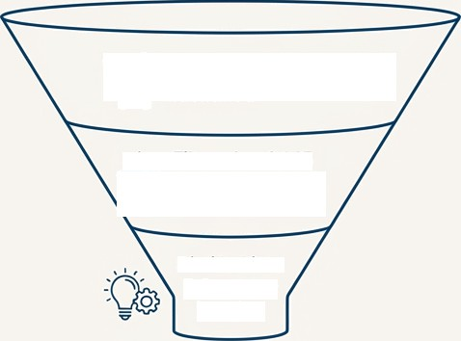
From 88,575Itemsets to 5 Key Business Insights
88,575 Frequent Itemsets Identified
\ t Filtered to 2,145 High-Confidence,
y > High-Lift Rules
Distilled into 5 Strategic Insights
$ Strategic Insights
The Central Role of Staple Products
Powerful Complementary Purchase Patterns
Hidden Cross-Category Opportunities
The Strategic Value of Directional Rules
A Framework for Actionable Decision-Making

Slide 8


Insight 1: Staple Products are the Anchors of the Shopping Basket
The Finding
Products like Atta, Rice, Cooking Oil, Potato, and Soap have extremely high support, appearing in the majority of all transactions. Atta, Potato, and Soap were present in 100^{O}a of the sample transactions.
The Insight
These items form the core of the household shopping trip. They are habitual, non-discretionary
purchases that drive customers to the store. Their presence in a basket is a near certainty.
Business Action
Pricing & Availability: Ensure these anchor products are always in stock and competitively priced. Stock- outs risk losing the entire basket, not just the single item.
Store Layout: Use these high-traffic items to guide customers past complementary and "é T higher-margin products.

Slide 9


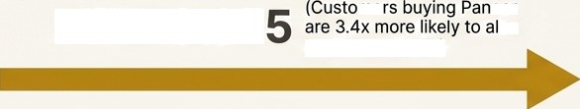


Insight 2: High-Lik Pairings Reveal Strong Bundling Opportunities
The Finding
The analysis uncovered several product groups purchased together far more often than by random chance.
LIFT: 3.37
me
eer
SO
buy Tea and Milk)
CONFIDENCE: 100%
(Paneer} (Tea, Milk}
Another Key Example: {Cooking Oil, Eggs) -> {Sugar) has a Lift of 3.0.
The Insight
These rules highlight strong complementary relationships, likely tied to specific meal occasions (e.g., chai
time snacks, baking preparation).
Business Action
Promotions: Create a 'Chai Time Snack' bundle offer with Paneer and premium tea brands.
Placement: Position a Paneer display near the dairy and tea aisles to trigger impulse purchases.

Slide 10





Insight 3: Shoppers Bridge Categories, Linking Groceries and Personal Care
The Finding
We identified meaningful associations between seemingly unrelated product categories. A key example is the
association between (Shampoo) and (Toothpaste, Rices.
Personal Care
Croceries
O
0
Rice
The Insight
Customers frequently combine essential grocery shopping with personal care top-ups in a single trip. The shopping journey is not siloed by department.
Business Action
Cross-Category Promotions: Run a promotion such as ‘Buy Skg of Rice and get 15% off select Shampoos.’
Layout Adjacencies: Test placing promotional end-caps for personal care items (like Toothpaste or Soap) within the high-traffic staple grocery aisles (like Rice or Atta).

Slide 11




Insight 4: The Direction of Purchase Matters
The Finding
Association rules are often asymmetrical. For example, the purchase of a specific item (antecedent) strongly predicts the purchase of another (consequent), but the reverse may not be true.
”Confidence: 100°4”*
Rice
{Biscuits} {Rice}
**Confidence: Much Lower**
The Insight
This directional nature is critical. It allows us to identify 'trigger' products that can be used to suggest or
promote 'destination' products.
Business Action
Recommendation Engines: Use directional rules to power 'You might also like...' suggestions on e-commerce platforms.
In-Store Signage: Place 'Don't Forget the Biscuits!' signs in the Rice aisle.
Checkout Prompts: Program POS systems to suggest a complementary item when a trigger item is scanned.

Slide 12


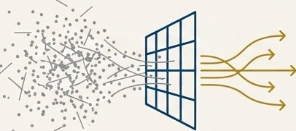

Insight 5: Framework for Confident, Data-Driven Decisions
The Finding
By filtering rules for high confidence (>=60@o) and high lift (>1), we systematically eliminated thousands of coincidental associations. Our final rule set of 2,145 rules represents statistically meaningful purchasing behaviors.
The Insight
This rigorous filtering ensures that business strategies are built on a reliable foundation. It separates true behavioral patterns from random noise, reducing the risk of acting on flawed assumptions.
Ti ue
Business Action
Merchandising Strategy: Use the final, filtered rule set as a primary input for quarterly merchandising and promotional planning.
A/B Testing: Prioritize A/B tests for store layouts and bundles based on the rules with the highest lift and support scores, as these represent the strongest opportunities.

Slide 13





From Raw Data to a Strategic Asset
This Market Basket Analysis has successfully translated raw transaction data into actionable business intelligence. We have moved from simple sales reports to a deep understanding of customer co-purchase behavior.
Key Opportunities Unlocked
**Shelf Optimization**: Data-backed logic for product placement.
**Promotional Design**: Creation of compelling, relevant bundle offers.
**Customer Recommendation**: A powerful engine for cross-selling.
**Strategic Planning**: A reliable framework for future retail decisions.

Slide 14



Recommended Next Steps: Putting Insights into Action
We recommend a phased approach to capitalize on these findings, starting with high-impact,
low-complexity initiatives.
Phase 1: Pilot Programs (Q1)
Action 1: Launch a pilot 'Chai
Time Snack’ bundle ({Paneer} +
{Tea, Milk}) in 10 test stores and
measure uplift in basket value.
Phase 2: Digital Integration (Q2)
Action 3: Integrate the top 20
highest-lift rules into the e-commerce site's recommendation engine
('Frequently Bought Together').
Phase 3: Scaled Rollout (Q3-Q4)
Action 4: Based on pilot results, develop a new national promotional calendar and update planograms for key categories.
Action 2: A/B test a cross- category end-cap display featuring (Shampoo} and
{Toothpaste} in the (Rice} aisle
of 5 stores.
G
NotebookLM

